Slide 1


http://www.comp.nus.edu.sg/~cs2100/
Recitation-6
MIPS – Processor Control
L12 videos

Slide 2
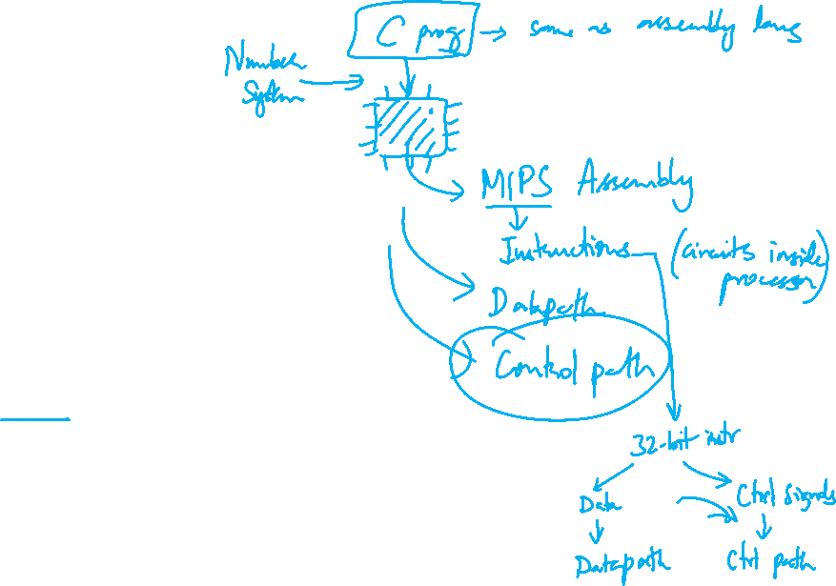
Agenda
MIPS Revision
Quiz questions
Extra Question in ISA
Mentimeter Quiz

Slide 3


Announcement
Consultation for Midterm
Date: 7th March 2025 (Friday)
Time: 1pm to 5pm.
Location: COM3-02-34 (my office).
Midterm Details

Slide 4
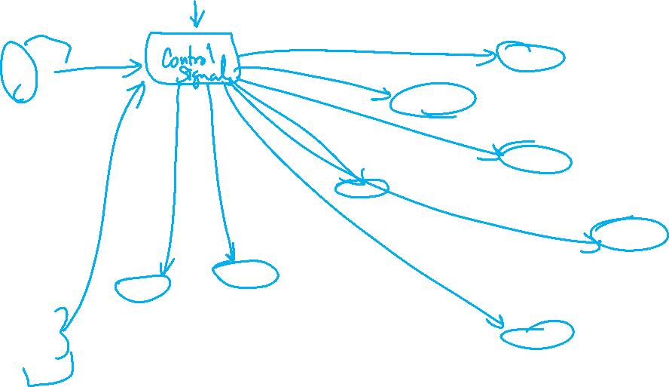
Complete Datapath
Instruction
Memory
PC
Add
MUX
Instruction
4
Left Shift 2-bit
Add
Address
PCSrc
ALUcontrol
Inst [25:21]
5
4
RR1
RD1
Inst [20:16]
5
RR2
is0?
MemWrite
Register
File
ALUSrc
ALU
opcode
31:26
rs
25:21
rt
20:16
rd
15:11
shamt
10:6
5
000000
01001
01010
01000
funct
5:0
WR
ALU
result
00000
MUX
100000
Address
RD2
MUX
WD
Data
Memory
MemToReg
Inst [15:11]
RegWrite
Read
Data
MUX
RegDst
Write
Data
Inst [15:0]
Sign Extend
MemRead

Slide 5
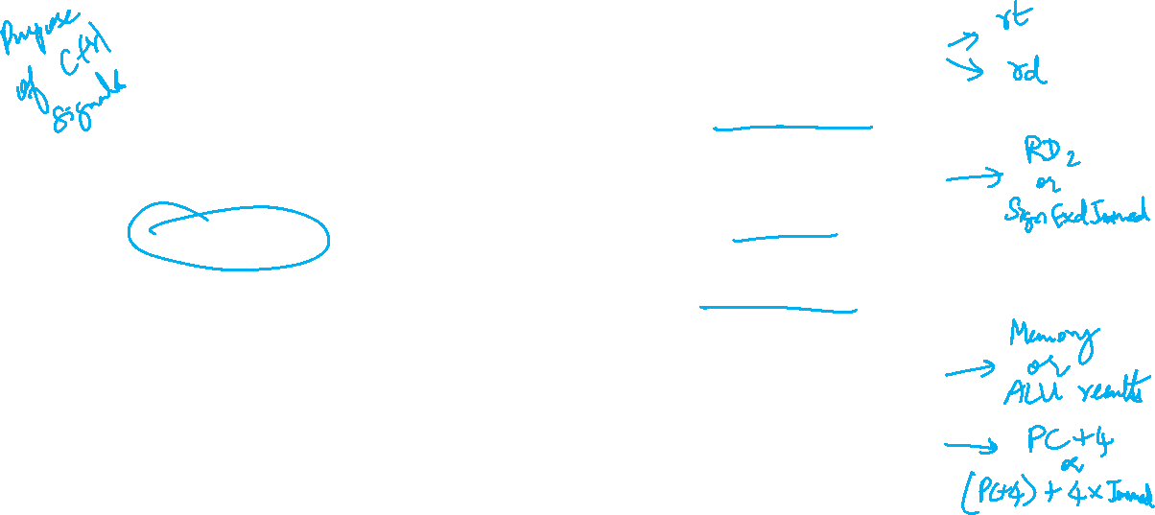
1. Identified Control Signals
Control Signal | Execution Stage | Purpose
RegDst | Decode/Operand Fetch | Select the destination register number
RegWrite | Decode/Operand Fetch RegWrite | Enable writing of register
ALUSrc | ALU | Select the 2nd operand for ALU
ALUcontrol | ALU | Select the operation to be performed
MemRead / MemWrite | Memory | Enable reading/writing of data memory
MemToReg | RegWrite | Select the result to be written back to register file
PCSrc | Memory/RegWrite | Select the next PC value

Slide 6

2. Generating Control Signals: Idea
The control signals are generated based on the instruction to be executed:
Opcode ➔ Instruction Format
Example:
R-Format instruction ➔ RegDst = 1 (use Inst[15:11]) )
R-Type instruction has additional information:
The 6-bit "funct" (function code, Inst[5:0]) field
Idea:
Design a combinational circuit to generate these signals based on Opcode and possibly Function code
A control unit is needed (a draft design is shown next)

Slide 7

The Control Unit (draft)
Instruction
Memory
PC
Add
MUX
Instruction
4
Left Shift 2-bit
Add
Address
Control
PCSrc
ALUcontrol
Inst [25:21]
5
4
RR1
RD1
Inst [20:16]
5
RR2
is0?
MemWrite
Register
File
ALUSrc
ALU
opcode
31:26
rs
25:21
rt
20:16
rd
15:11
shamt
10:6
5
000000
01001
01010
01000
funct
5:0
WR
ALU
result
00000
MUX
100000
Address
RD2
MUX
WD
Data
Memory
MemToReg
Inst [15:11]
RegWrite
Read
Data
MUX
RegDst
Write
Data
Inst [15:0]
Sign Extend
MemRead

Slide 8
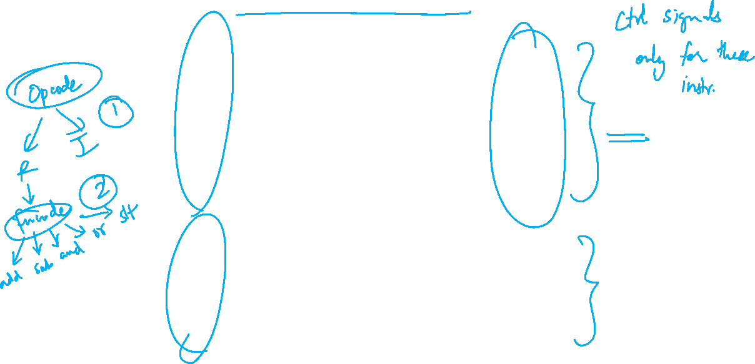
3. MIPS Instruction Subset (Review)
opcode
shamt
funct
31
25
20
15
10
5
add
0₁₆
rs
rt
rd
0
20₁₆
sub
0₁₆
rs
rt
rd
0
22₁₆
and
0₁₆
rs
rt
rd
0
24₁₆
R-type
or
0₁₆
rs
rt
rd
0
25₁₆
slt
0₁₆
rs
rt
rd
0
2A₁₆
31
25
20
15
lw
23₁₆
rs
rd
offset
sw
2B₁₆
rs
rd
offset
I-type
beq
4₁₆
rs
rd
offset

Slide 9

4. Midpoint Check
Control Signal | Execution Stage | Purpose
RegDst | Decode/Operand Fetch | Select the destination register number
RegWrite | Decode/Operand Fetch RegWrite | Enable writing of register
ALUSrc | ALU | Select the 2nd operand for ALU
ALUcontrol | ALU | Select the operation to be performed
MemRead / MemWrite | Memory | Enable reading/writing of data memory
MemToReg | RegWrite | Select the result to be written back to register file
PCSrc | Memory/RegWrite | Select the next PC value
We have gone through almost all of the signals:
Left with the more challenging ALUcontrol signal
Observation so far:
The signals discussed so far can be generated by opcode directly
Function code is not needed up to this point
A major part of the controller can be built based on opcode alone

Slide 10
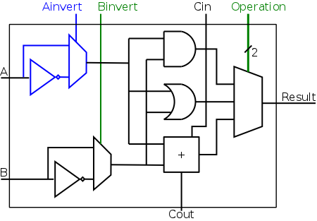
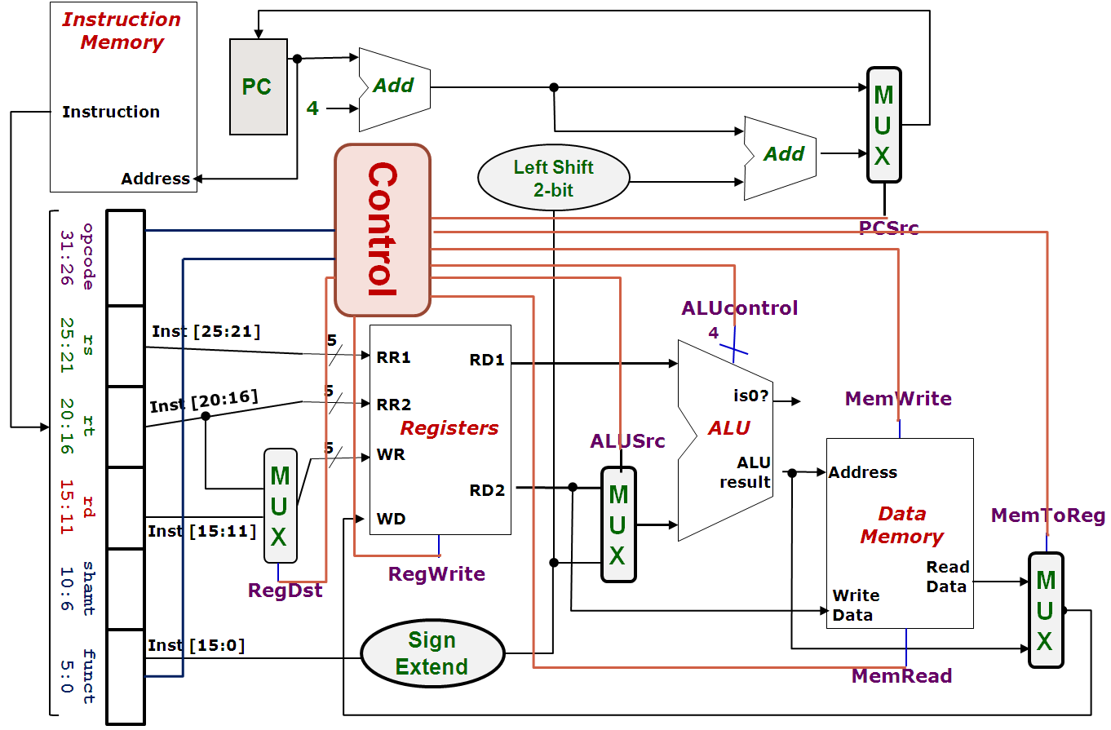
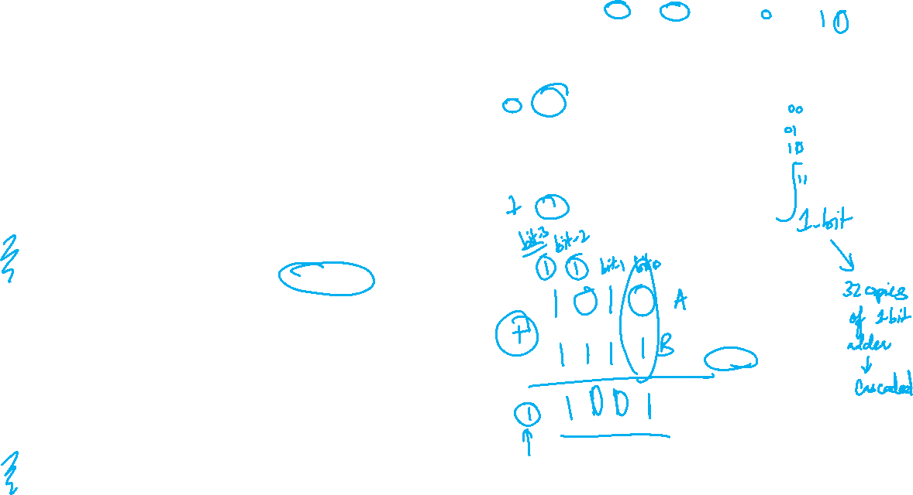
MIPS-Revision
ALUcontrol | Function
0000 | AND
0001 | OR
0010 | add
0110 | subtract
0111 | slt
1100 | NOR

Slide 11

5. One Bit At A Time (Aha!)
Can you see how the ALUcontrol (4-bit) signal controls the ALU?
Note: implementation for slt not shown
ALUcontrol |  |  | Function
Ainvert | Binvert | Operation
0 | 0 | 00 | AND
0 | 0 | 01 | OR
0 | 0 | 10 | add
0 | 1 | 10 | subtract
0 | 1 | 11 | slt
1 | 1 | 00 | NOR
00
01
MUX
10
Acknowledgement: Image taken from NYU Course CSCI-UA.0436

Slide 12

5. Multilevel Decoding
Now we can start to design for ALUcontrol signal, which depends on:
Opcode (6-bit) field and Function Code (6-bit) field
Brute Force approach:
Use Opcode and Function Code directly, i.e. finding expressions with 12 variables
Multilevel Decoding approach:
Use some of the input to reduce the cases, then generate the full output
Simplify the design process, reduce the size of the main controller, potentially speedup the circuit

Slide 13

5. Intermediate Signal: ALUop
Basic Idea:
Use Opcode to generate a 2-bit ALUop signal
Represents classification of the instructions:
Use ALUop signal and Function Code field (for R-type instructions) to generate the 4-bit ALUcontrol signal
Instruction type | ALUop
lw / sw | 00
beq | 01
R-type | 10

Slide 14
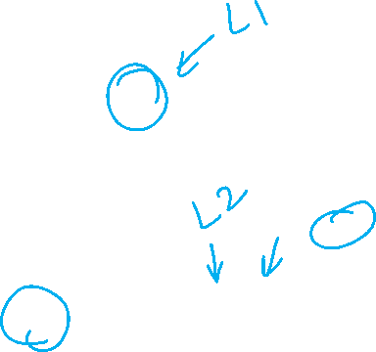
5. Two-level Implementation
Step 1.
Generate 2-bit ALUop signal from 6-bit opcode.
6
Control
Step 2.
Generate ALUcontrol signal from ALUop and optionally 6-bit Funct field.
ALUop
2
00: lw, sw
01: beq
10: add, sub, and, or, slt
opcode
31:26
rs
25:21
rt
20:16
rd
15:11
shamt
10:6
funct
5:0
ALU
4
ALUcontrol
0000: and
0001: or
0010: add
0110: sub
0111: set on less than
ALU Control
6

Slide 15
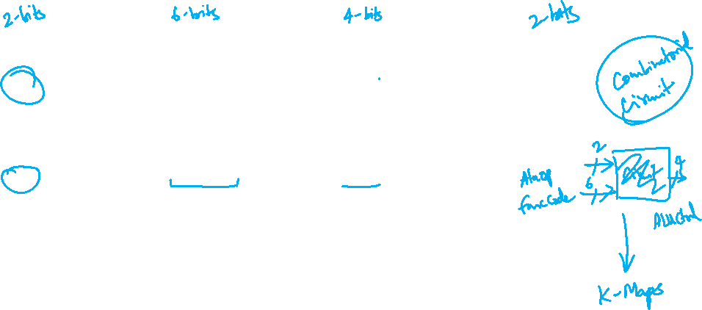
5. Generating ALUcontrol Signal
Opcode | ALUop | Instruction Operation | Funct field | ALU action | ALU control
lw |  | load word |  | add
sw |  | store word |  | add
beq |  | branch equal |  | subtract
R-type |  | add |  | add
R-type |  | subtract |  | subtract
R-type |  | AND |  | AND
R-type |  | OR |  | OR
R-type |  | set on less than |  | set on less than
Instruction Type | ALUop
lw / sw | 00
beq | 01
R-type | 10
00
xxxxxx
0010
00
xxxxxx
0010
01
xxxxxx
0110
10
10 0000
0010
10
10 0010
0110
10
10 0100
0000
ALUcontrol | Function
0000 | AND
0001 | OR
0010 | add
0110 | subtract
0111 | slt
1100 | NOR
10
10 0101
0001
10
10 1010
0111
Generation of 2-bit ALUop signal will be discussed later


Slide 16
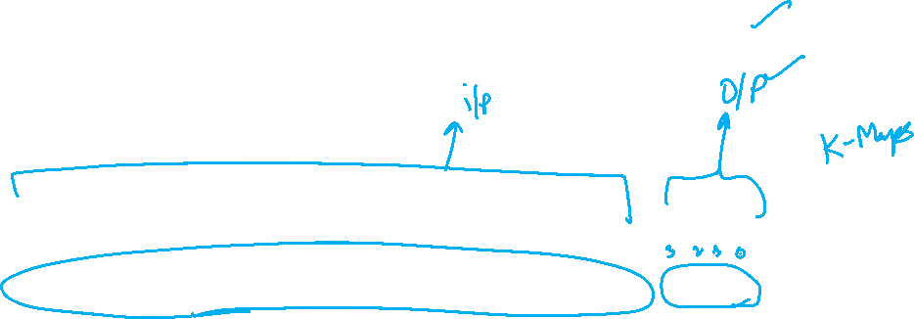
5. Design of ALU Control Unit (1/2)
Input: 6-bit Funct field and 2-bit ALUop
Output: 4-bit ALUcontrol
Find the simplified expressions
ALUcontrol3 = 0
ALUcontrol2 = ?
ALUop0 + ALUop1⋅ F1
 | ALUop |  | Funct Field ( F[5:0] == Inst[5:0] ) |  |  |  |  |  | ALU control
 | MSB | LSB | F5 | F4 | F3 | F2 | F1 | F0
lw
sw
beq
add
sub
and
or
slt
0
0
X
X
X
X
X
X
0 0 1 0
0
0
X
X
X
X
X
X
0 0 1 0
X
0
1
X
X
X
X
X
X
0 1 1 0
1
0
1
0
0
0
0
0
0 0 1 0
X
X
X
1
0
1
0
0
0
1
0
0 1 1 0
X
X
X
1
0
1
0
0
1
0
0
0 0 0 0
X
X
X
1
0
1
0
0
1
0
1
0 0 0 1
X
X
X
1
X
X
X
0
1
0
1
0
1
0
0 1 1 1


Slide 17

5. Design of ALU Control Unit (2/2)
Simple combinational logic
ALUop
2
ALU Control block
ALUcontrol2
= ALUOp0 + ALUOp1∙F1
ALUOp0 (LSB)
ALUOp1 (MSB)
ALUcontrol3
0
ALUcontrol2
F3
ALUcontrol1
ALUcontrol
F2
F(5-0)
F1
ALUcontrol0
F0

Slide 18
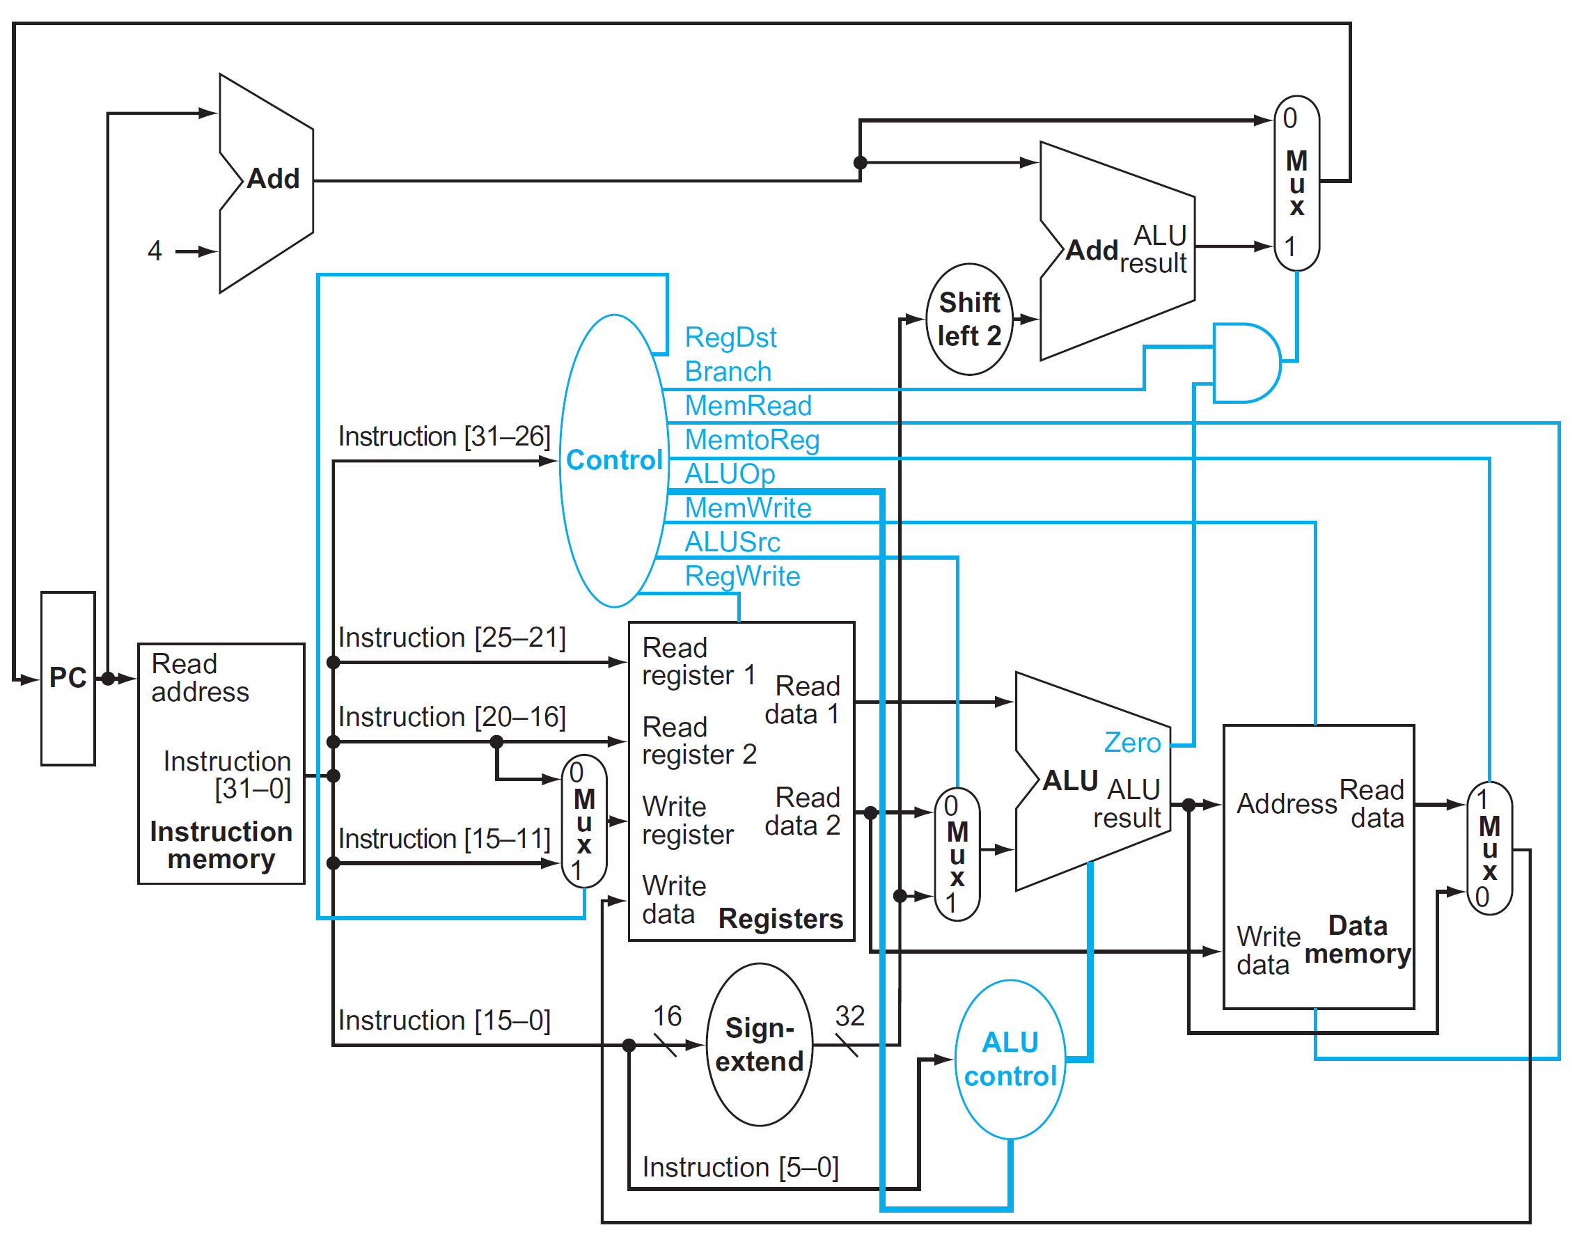

5. Control Design: Outputs
 | RegDst | ALUSrc | MemToReg | Reg Write | Mem Read | Mem Write | Branch | ALUop
 |  |  |  |  |  |  |  | op1 | op0
R-type
lw
sw
beq
1
0
0
1
0
0
0
1
0
0
1
1
1
1
0
0
0
0
X
1
X
0
0
1
0
0
0
X
0
X
0
0
0
1
0
1

Slide 19
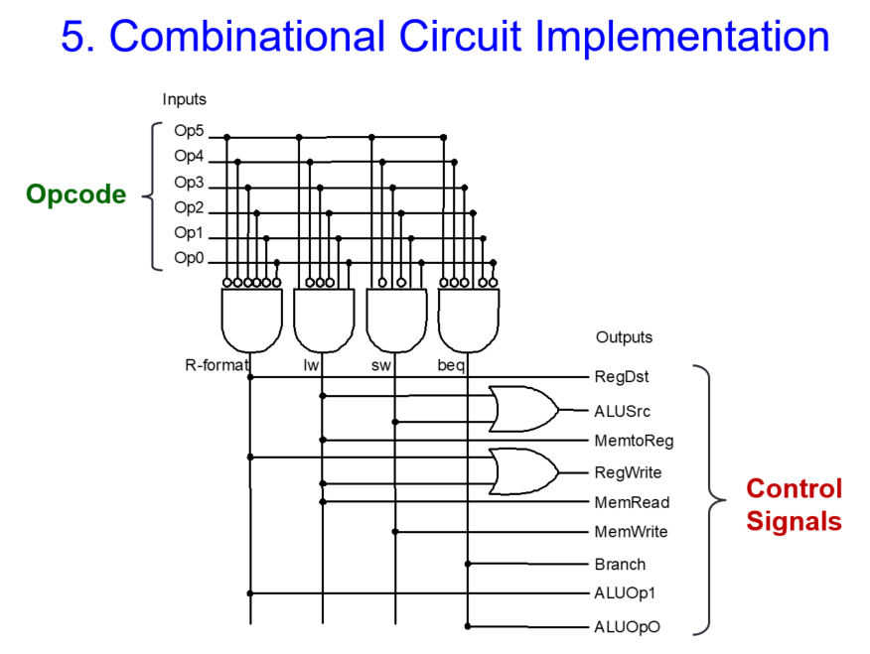
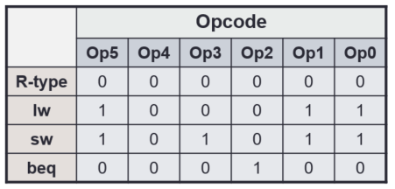
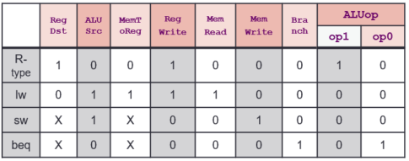
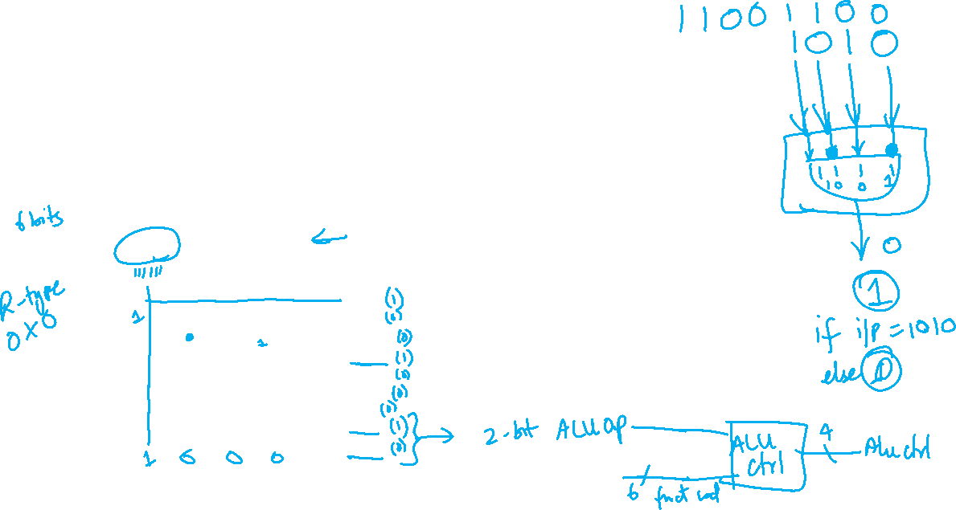
Final Control Circuit

Slide 20
Quiz Solutions

Slide 21
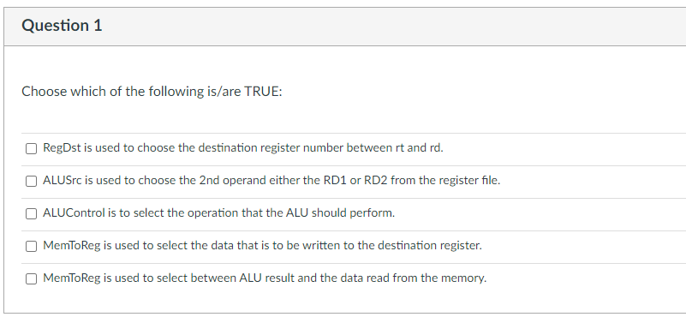
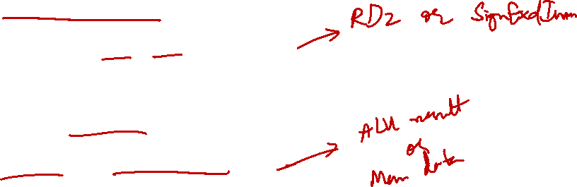
Week-6 MIPS Quiz

Slide 22
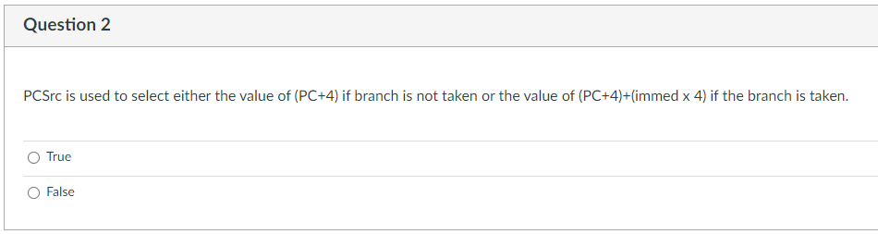

Week-6 MIPS Quiz
PCSrc

Slide 23
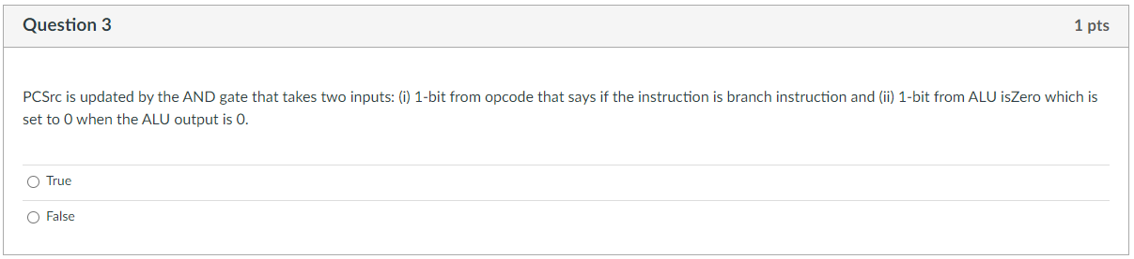

Week-6 MIPS Quiz

Slide 24
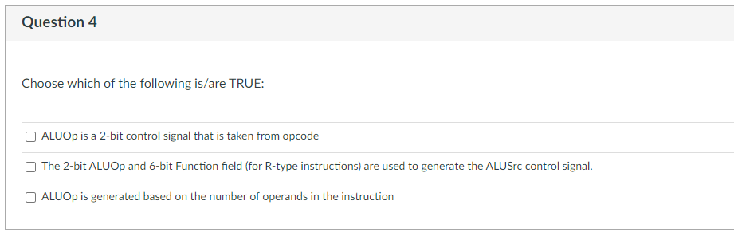
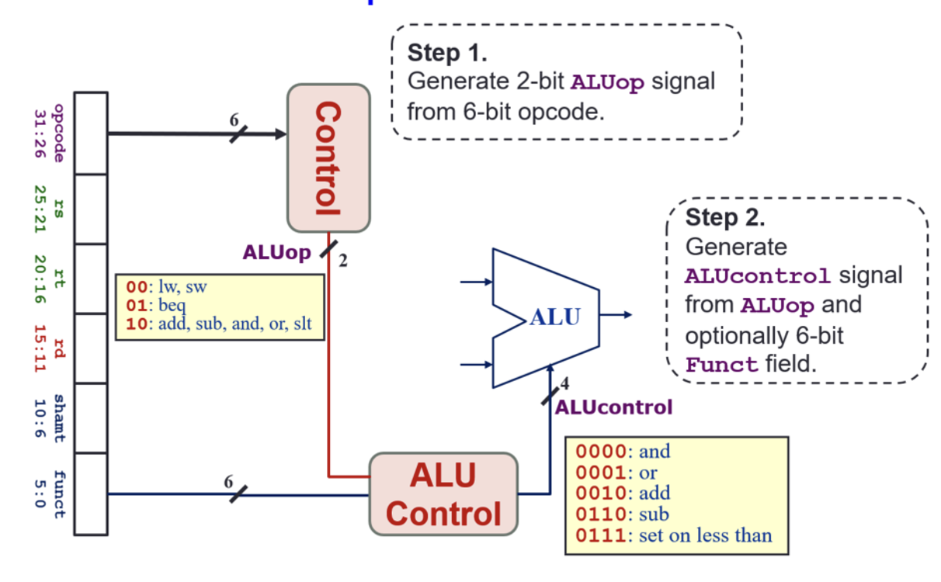
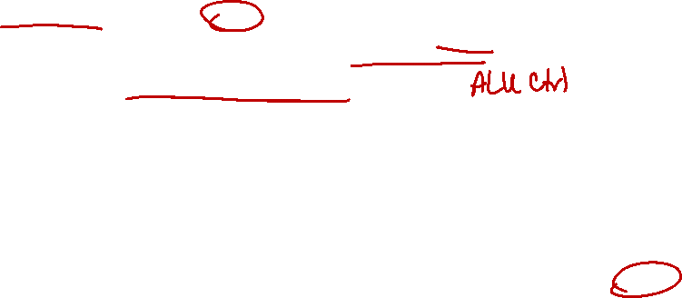
Week-6 MIPS Quiz

Slide 25
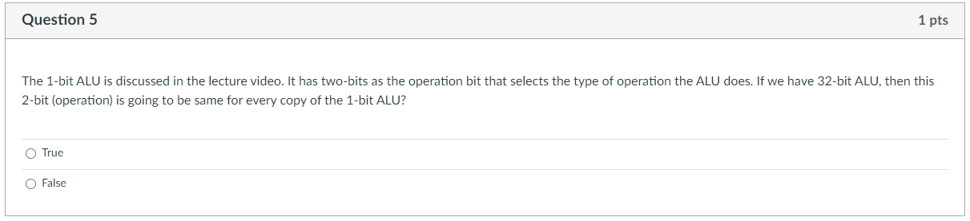

Week-6 MIPS Quiz

Slide 26
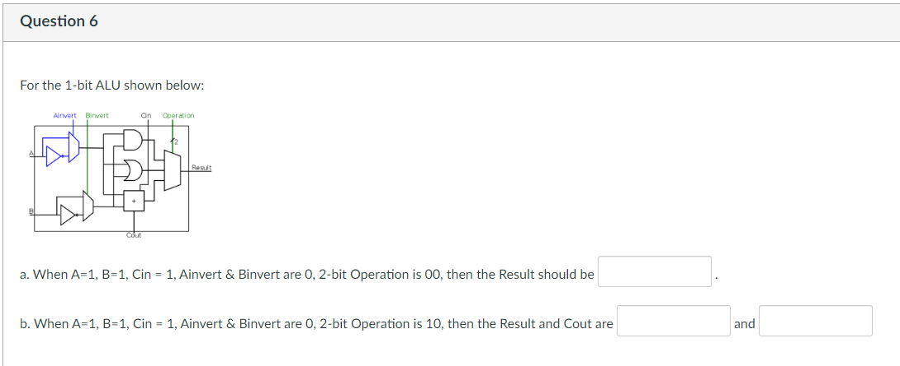
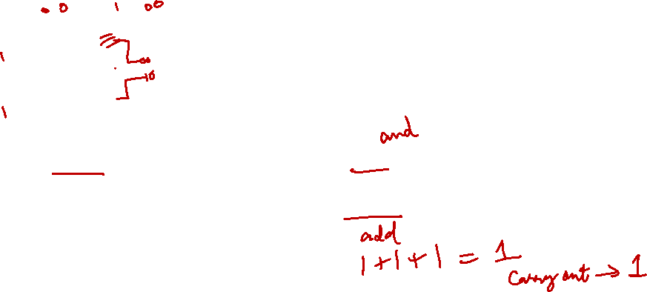
Week-6 MIPS Quiz
1
1
1

Slide 27
Extra Question

Slide 28
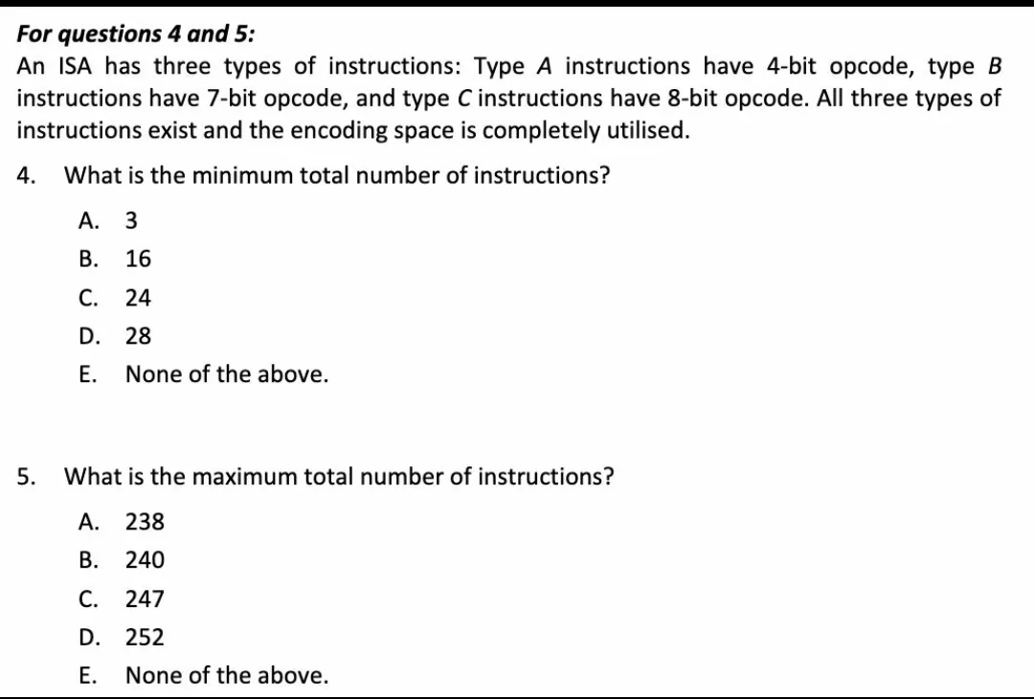
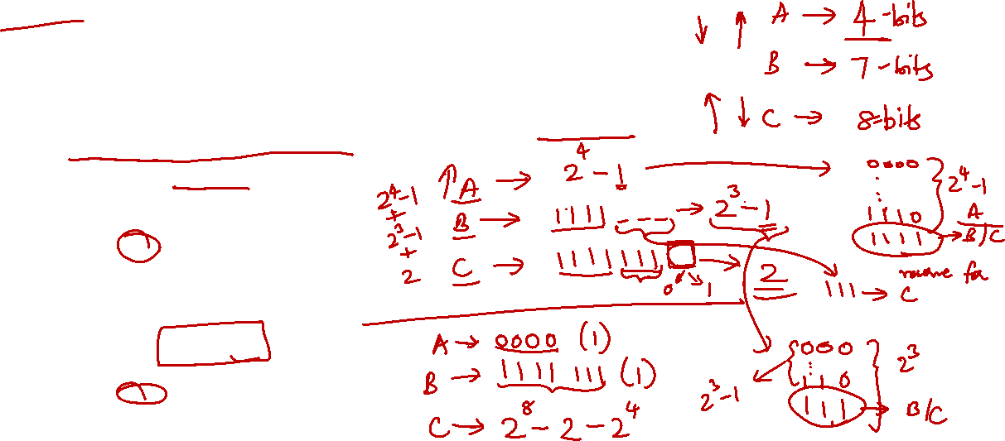
ISA – finding min and max instructions

Slide 29

Mentimeter Quiz

Slide 30
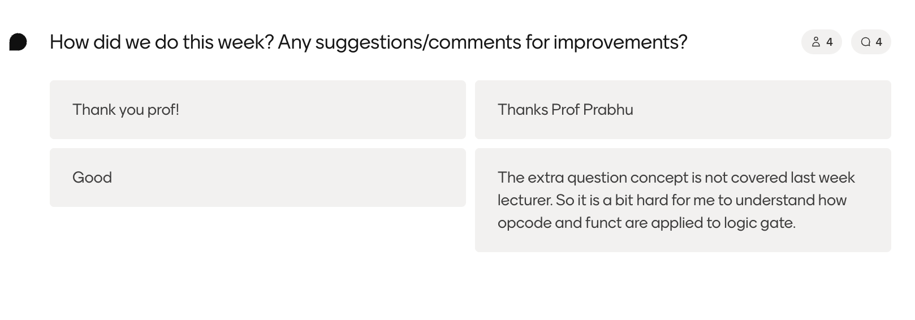
Mentimeter Quiz

Slide 31

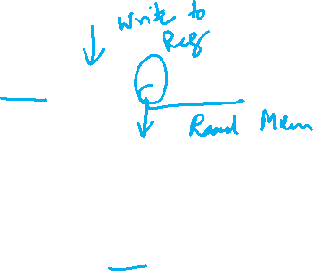
Q1
For the MIPS instruction lw $t0, 8($s1), which of the following control signals should be enabled (1)?
Options: A) RegWrite = 1, ALUSrc = 1, MemRead = 1, MemWrite = 0 B) RegWrite = 1, ALUSrc = 0, MemRead = 0, MemWrite = 1 C) RegWrite = 0, ALUSrc = 1, MemRead = 1, MemWrite = 0 D) RegWrite = 1, ALUSrc = 1, MemRead = 0, MemWrite = 1

Slide 32

Q2
For the MIPS instruction beq $t1, $t2, Label, which of the following control signals should be enabled (1)?
Options: A) RegWrite = 0, ALUSrc = 1, Branch = 1, MemRead = 0 B) RegWrite = 1, ALUSrc = 0, Branch = 1, MemRead = 0 C) RegWrite = 0, ALUSrc = 0, Branch = 1, MemRead = 0 D) RegWrite = 0, ALUSrc = 0, Branch = 0, MemRead = 1

Slide 33

Q3
For the MIPS instruction andi $t5, $t6, 0xFF, which set of control signals should be enabled (1)?
Options:
A) RegWrite = 1, ALUSrc = 1, MemWrite = 1, MemRead = 0 B) RegWrite = 1, ALUSrc = 1, MemWrite = 0, MemRead = 1 C) RegWrite = 1, ALUSrc = 1, MemWrite = 0, MemRead = 0 D) RegWrite = 0, ALUSrc = 0, MemWrite = 1, MemRead = 0

Slide 34

Q4
Which of the following correctly describes the role of the ALU Control unit in the MIPS control path?
Options: A) It directly selects the ALU operation based on the instruction opcode B) It determines the ALU operation based on both the ALUOp field and the funct field (for R-type instructions) C) It only controls arithmetic operations and does not affect logical operations D) It sends control signals to memory for read/write operations

Slide 35

Q5
When executing the MIPS jump (j target) instruction, which of the following correctly represents the control signals activated in the control path? (make a guess)
Options | RegDst | ALUSrc | MemRead | MemWrite | Branch | Jump | RegWrite
A | X | X | 1 | 0 | 0 | 1 | 1
B | 0 | 1 | 0 | 0 | 1 | 0 | 0
C | X | X | 0 | 0 | 0 | 1 | 0
D | 1 | 0 | 1 | 1 | 0 | 1 | 1

Slide 36
End of File

